Slide 1
Coptic Lesson 14
Coptic Pronouns

Slide 2
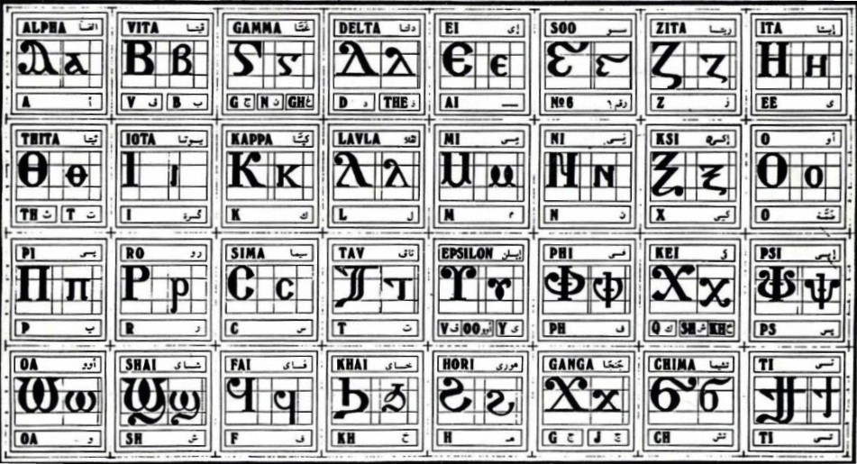
Coptic Alphabets

Slide 3
Review Questions
Coptic
Name
English
'
Epsee
ps
d
Delta
d, z
¢
Marturoc
Martyr
=b
`cnau
2
f
Fai
f
g
Ghamma
gh, g, n
=c
`cnau-se
200

Slide 4
Rule for the Ghamma G
e-family:
e> y> i> u
g
(before e-family)
G =
gh
(otherwise)
n
(before g> x> k> ,)
Examples:
genoc
agora
aggeloc
agioc
`gravy
calpigx
gumnacia

Slide 5
Coptic Reading – Part 13
ai ia oi io iom
la [i [wm pan ran
cam [ah map mar jij
cat fat `sne cen] qer
qen sai pisai swi piswi
sep syp `fsyp can cyt
con cwni coni pan ran
ial moi amoi iwt cwma
jwr jwri `cnof ]`aco ]`pla
qaq qwq ja[i ren maren

Slide 6
Coptic Bible Verses
Anok pe piAlva nem piW ]ar,y nem pijwk ebol. "I am the Alpha and the Omega, the Beginning and the End." (Rev 1:8)
Anok pe piwik `nte `pwnq. "I am the Bread of life." (Jn 6:35)
Anok pe `vouwini `mpikocmoc. "I am the light of the world." (Jn 8:12)
Matai `epekiwt nem tekmau. "Honor your father and your mother." (Eph 6:2)

Slide 7
Beginer vocabulary Review
romi kahi `Vnou] `alou ioh
ry con syri iwt bal
yi ran ro ouro nyb
`chimi vorsi seri ourw ri
cwni ajp ve sau soury
mau ]`alou jij `;nyb hiomi
nicwni nirwmi niran nimau ni`alou
jom niourw nibal nisau ninyb
niseri totc io] ourwou vyou`i

Slide 8
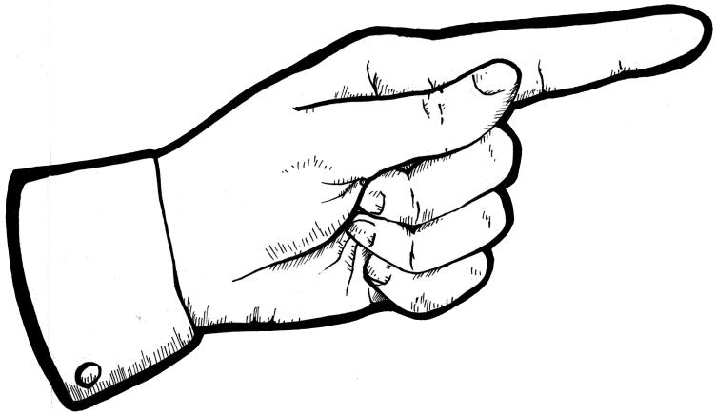
Personal pronouns
`Anok
`N;ok
`N;o
`N;of
`N;oc
`Anon
`N;wten
`N;wou
I (m,f)
You (masc. sing.)
You (fem. sing.)
He
She
We
You (plur. m & f)
They (m & f)

Slide 9
Connectors for Simple being
pe _ am, is (singular masculine)
te _ am, is (singular feminine)
ne _ are (plural masculine & feminine)
Examples:
`anok pe pirwmi.
I am the man.
`anok ourwmi pe.
I am a man

Slide 10
Exercise (Part 1)
Translate the following into English:
`n;of pe pi`alou.
He is the boy.
`n;of oualou pe.
He is a boy.
`n;oc te ]`chimi.
She is the woman.
`n;oc ou`chimi te.
She is a woman.
`n;ok pe picon.
You are the brother
`n;ok oucon pe.
You are a brother
`n;o te ]cwni.
You are the sister.
`n;o oucwni te.
You are a sister.
anon han`cnyou ne.
We are brothers.
`n;wten hansyri ne.
You are sons.
`n;wou ne nihiomi.
They are the women.
`n;wou hanhiomi ne.
They are women.

Slide 11
Announcement
All slides are available at http://www.ekladious.com/coptic.html

Slide 12
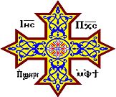
Oujai qen `P[oic

